Slide 1













Gesellschaftliche-
Umwelt-Verhältnisse
Eigene Darstellung

Slide 2
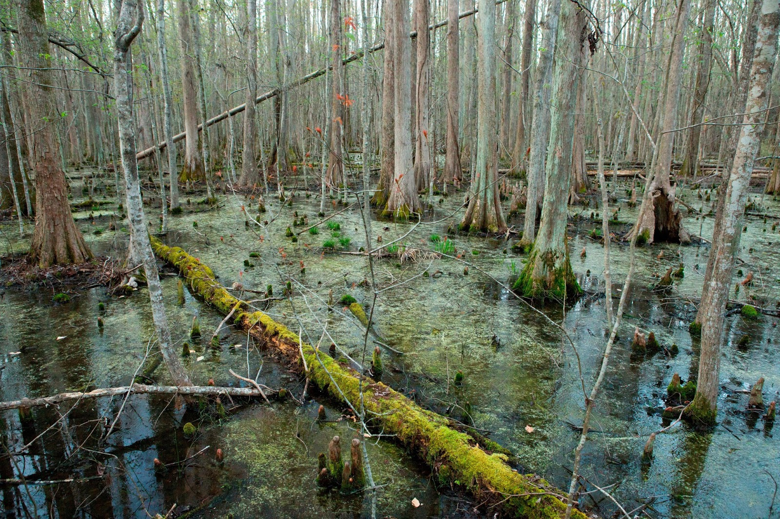
Küstenfeuchtgebiete in den USA
Albert-Ludwigs-Universität Freiburg
Regionale Geographie Europa und andere Kontinente
Von Anna-Louisa Spielmann
WS 22/23
https://2.bp.blogspot.com/-wrHwR6T8y3w/V938HCDpPMI/AAAAAAAAA58/DLbJXukhVX8HJxGFdHx9mL0-kq7kCb2ewCLcB/s1600/_greatdismalswamp.jpg

Slide 3
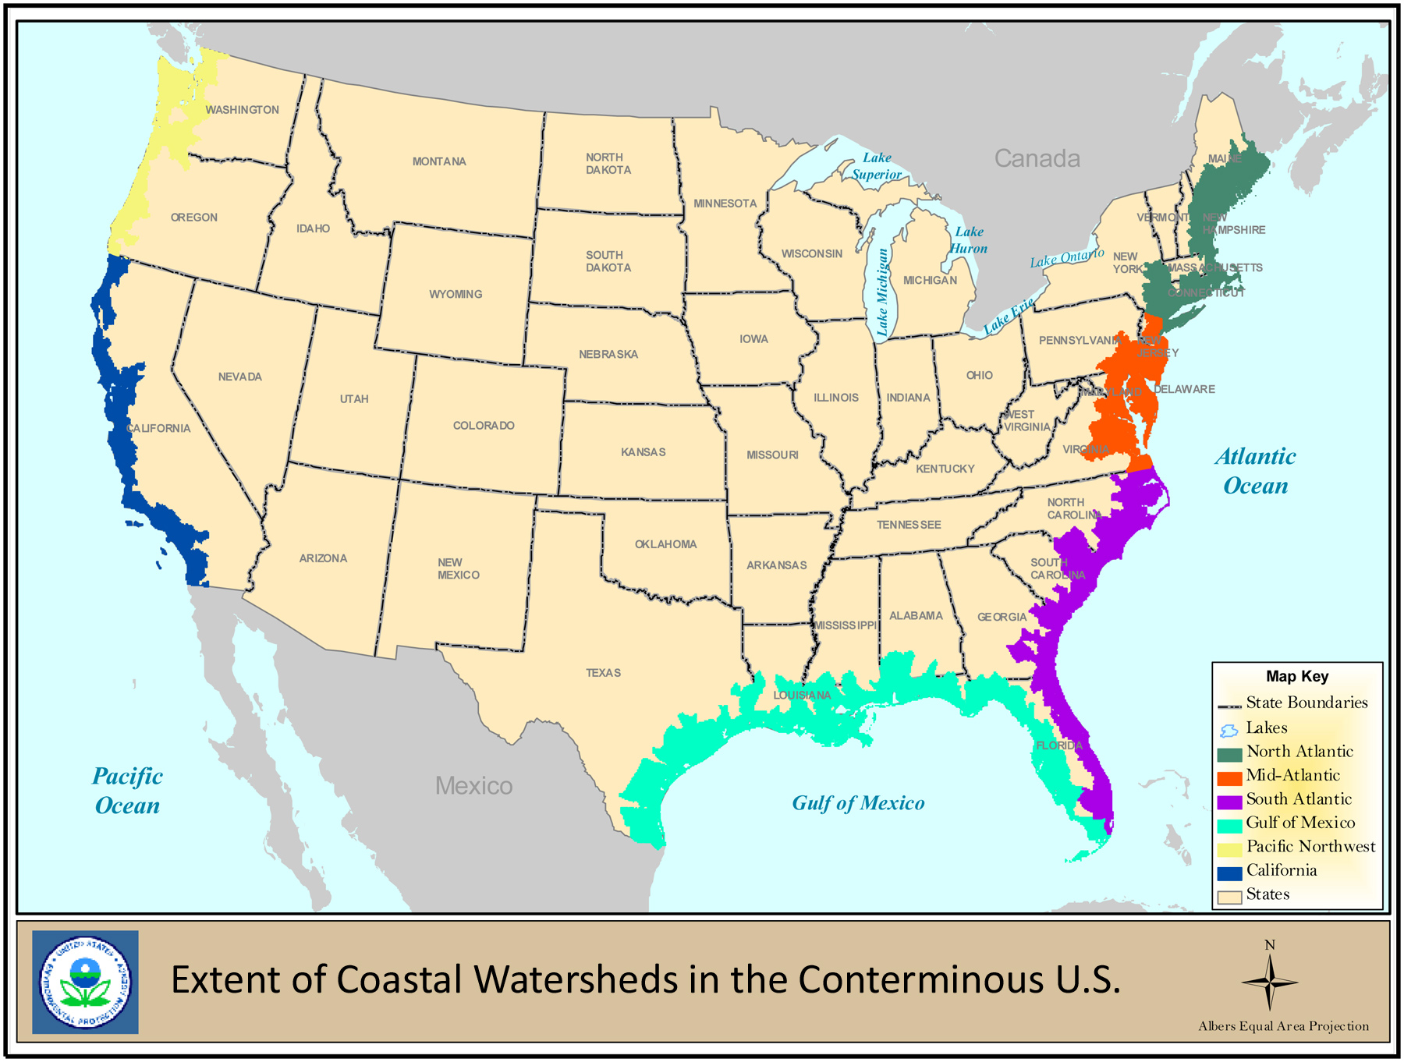
EPA What are coastal wetlands, <https://www.epa.gov/sites/default/files/styles/large/public/2015-04/newmap_large.jpg?itok=she7VRBL>.

Slide 4
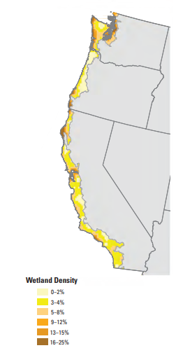
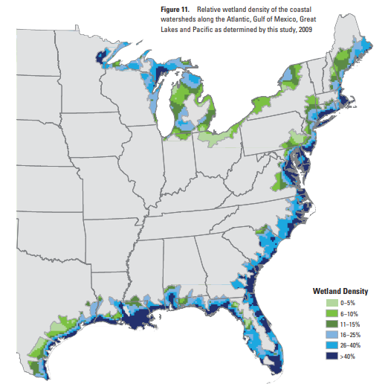
Aus Status and Trends of Wetlands IN THE COASTAL WATERSHEDS OF THE CONTERMINOUS UNITED STATES 2004 to 2009, Dahl und Stedman.

Slide 5
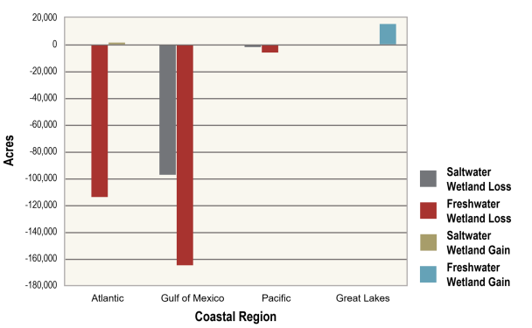
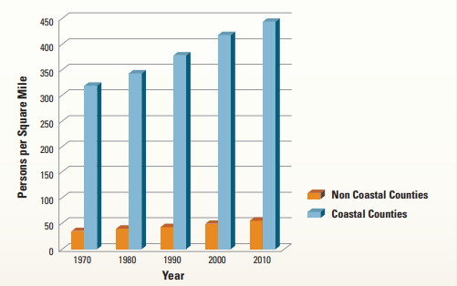
Wetland gains and losses in the coastal watersheds of each coastal region betwenn 2004 and 2009, as depicted in Dahl ans Stedman, 2013.
Aus Status and Trends of Wetlands IN THE COASTAL WATERSHEDS OF THE CONTERMINOUS UNITED STATES 2004 to 2009, Dahl und Stedman.
Changes in population density in the conterminous United States from 1970 to 2010. Data adapted from NOAA, 2012.

Slide 6
